Slide 1



Infosys Springboard |
STROKE DATA
ANALYSIS
Using Deep Learning
NAME OF PROJECT:
PRESENTED BY:
Stroke Data Analysis
Utkrisht Verma

Slide 2


03 | Timeline
05 | Data Cleaning
07 | Data Visualisation
10 | Encoding Techniques
11 | Model Training and Optimising Model
09 | Final Model Evaluation
10 | Dataset Analysis
Agenda

Slide 3


Timeline
03
Milestone 1
Milestone 2
Milestone 3
Milestone 4
Data Preparation
Data Visualisation
Data Encoding
Model Training and Optimiastion

Slide 4


04
Data Preperation
Goal # 1
Goal # 1
Goal # 1
Exploratory Analysis
Analysis of Attributes and Records.
Elaborate on the first
goal here.

Slide 5

05
Analysis | Observation
Shape | Dataset Contains 5110 rows and 12 Columns
Info | BMI Column has missing vlues
Describe | Analyse key features like age, avg_glucode_level
isnll | Checked the number of values which have null values.
Dataset Characterestics
Key Columns Include age, gender, hypertension, heart_disease, work_type, avg_glucose_level and the target variable is stroke

Slide 6
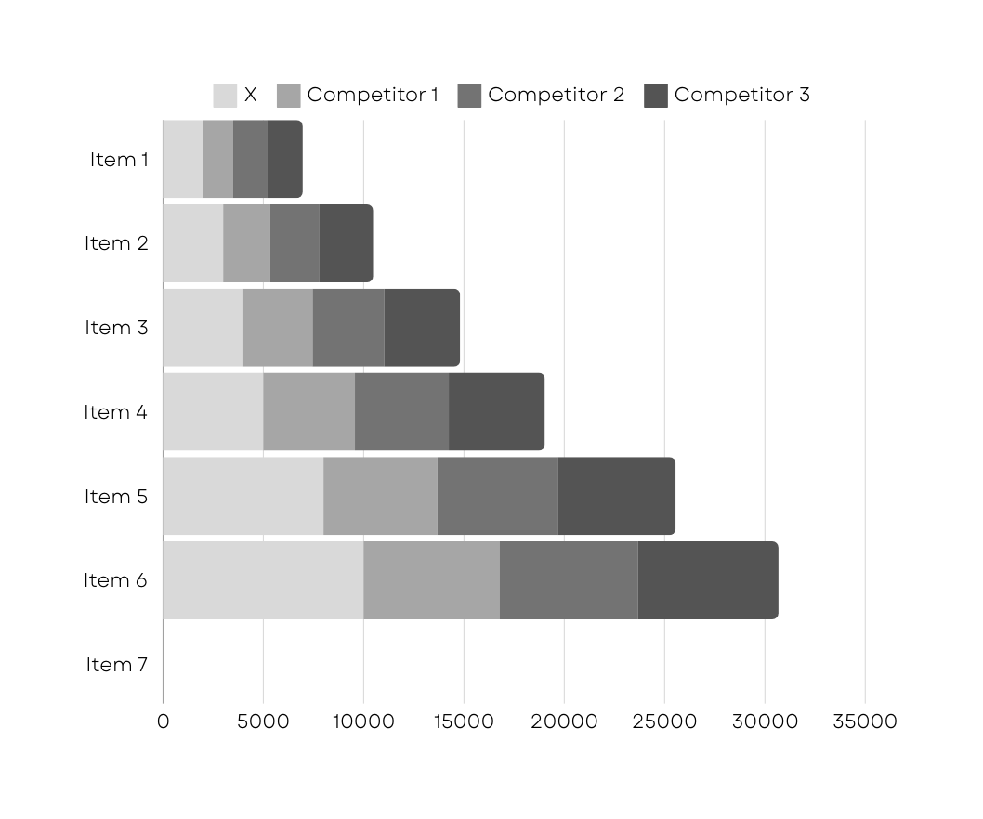
Data Visualisation
06
This part focuses on exploring the dataset visually to uncover meaningful patterns
and relationships between variables. We analyze trends
and distributions through graphs and plots, helping identify key insights related to stroke prediction.
Additionally, data encoding ensures that categorical variables are transformed into
a format suitable for machine learning models.

Slide 7
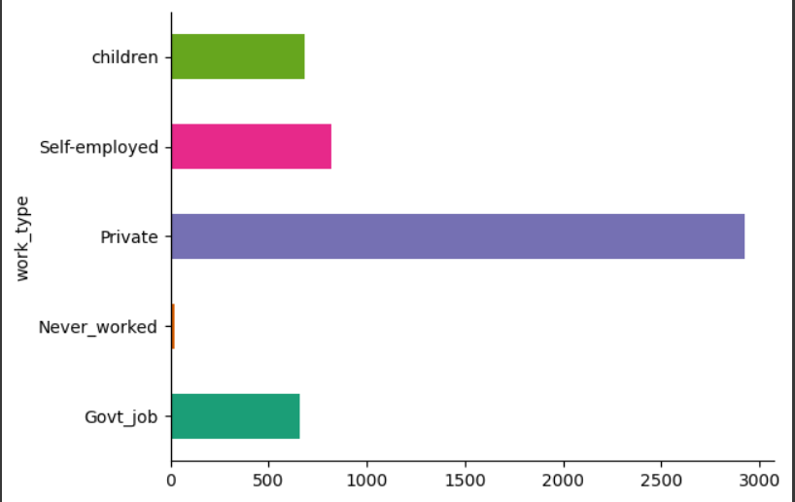
Work Type vs Frequency
07
People working in Private Jobs have the maximum frequency of stroke patients.
Followed by the people who are Self - Employed.

Slide 8
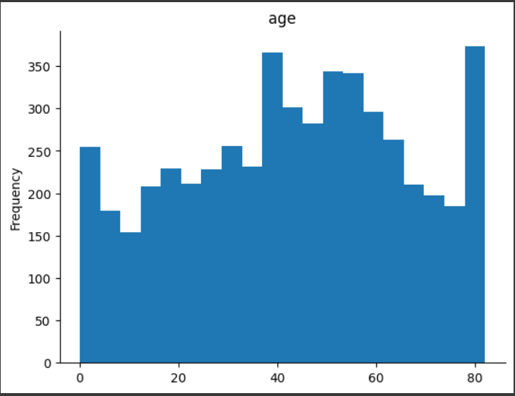
Frequency Vs Age Group
08
The stroke is centralized within the age group of 40 to 80.
This implies that older people have a higher chances of getting a stroke.

Slide 9


09
Resistance Type | 0 for Rural 1 for Urban
Work Type | Never Worked Private Self - Employed
Smoking Status | Never Smoked Formally Smoked Currently Smokes
Data Encoding
This process is the process of converting categorical data into numerical formats so that machine learning algorithms can interpret it.

Slide 10

10
Machine Learning
Machine Learning models are algorithms that enable computers to learn patterns from data and make predictions without explicitly being programmed.

Slide 11
11
ML Model | RSME | Accuracy
Linear Regression | 0.2345 | 0.94497
Lasso Regression | 0.2367 | 0.94396
Ridge | 0.2345 | 0.94497
Logistic | 0.2533 | 0.9358
Benchmarks

Slide 12
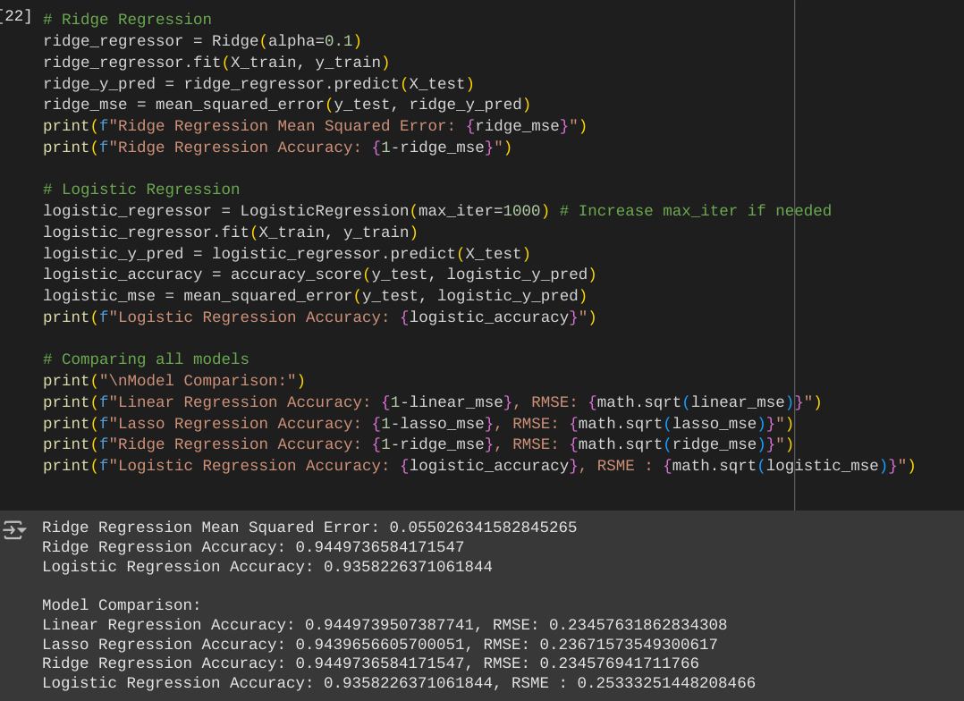
12
Thank You!

